Slide 1
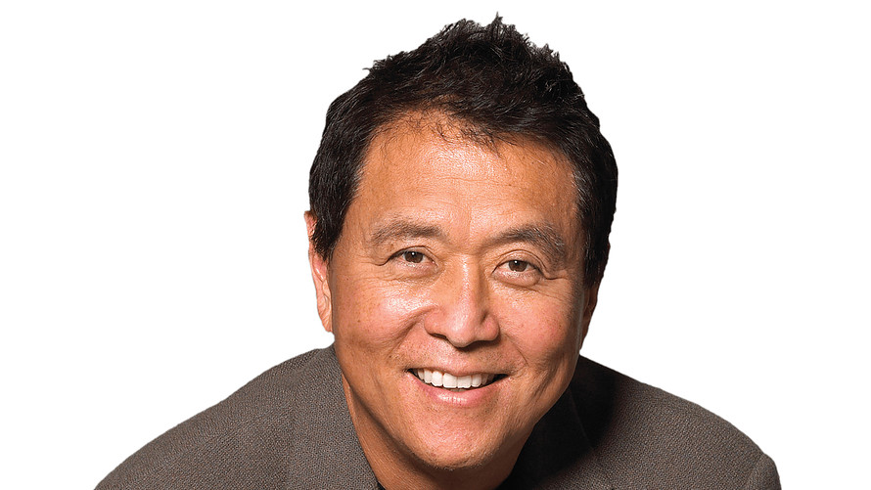
‘Rich Dad’ author Robert Kiyosaki
On flunking out of school -- three times:
“I flunked out of school three times, because I can’t write, and I couldn’t type. I flunked out of accounting. What do I write all day about? And type all day about? Accounting. Accounting is the subject. If you’re going to do anything, start with a bookkeeping course. You’ve got to know your numbers. Numbers tell you a story. After you get through a basic bookkeeping course…then you can take basic business accounting. That’s how you learn, it’s in the numbers. If you can’t read the numbers, you don’t know what’s going on. It’s not that hard to get ahead quickly because most people highly educated, with good grades, have no financial education.”

Slide 2


Slide 3

Some news…
1. What do you think will happen to Samsung profits?
2. Why?
3. How would you expect the stock price to react to the earnings release?

Slide 4
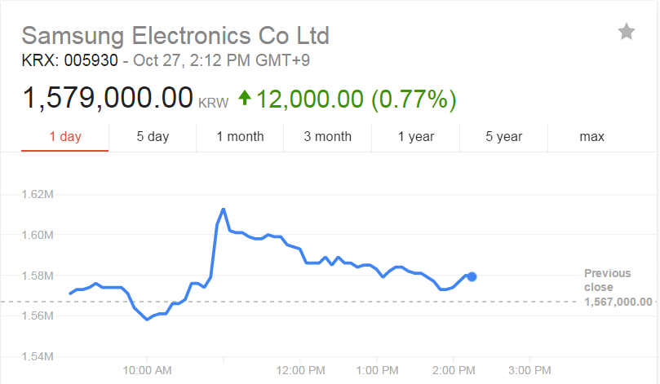
Some news…

Slide 7
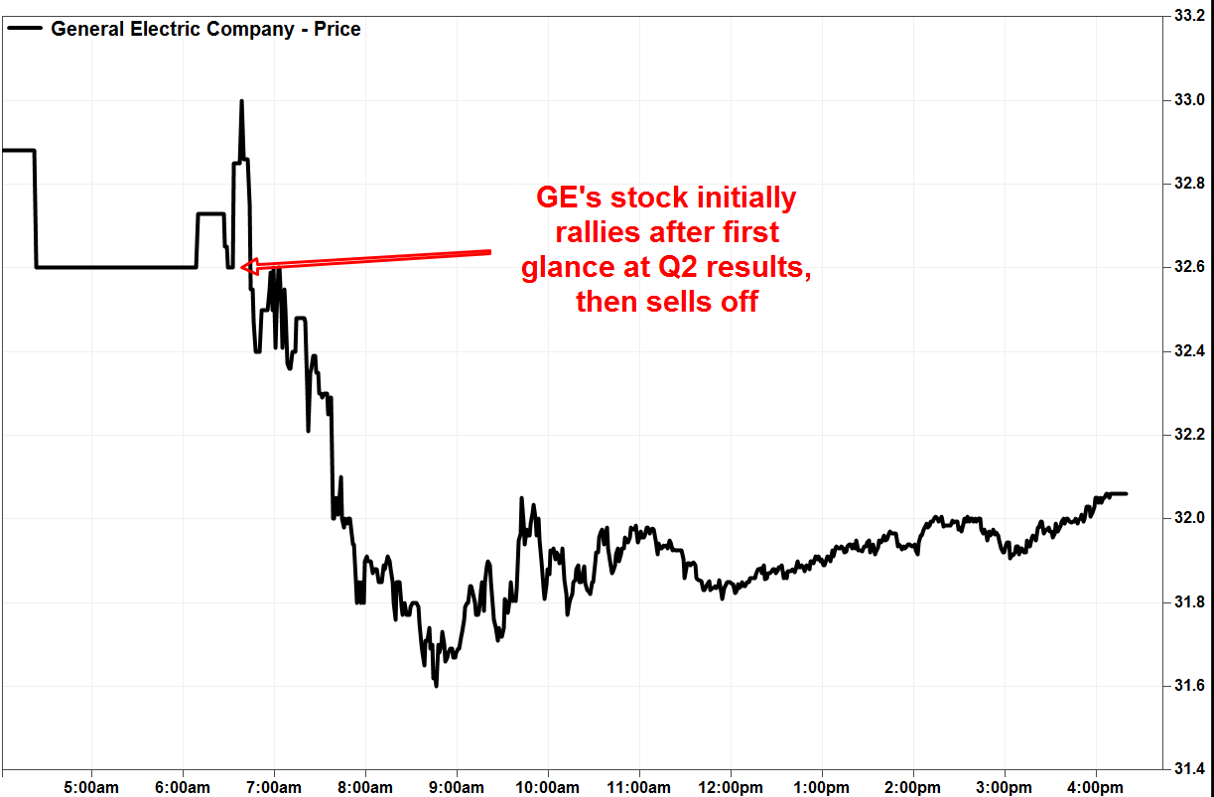

Slide 8
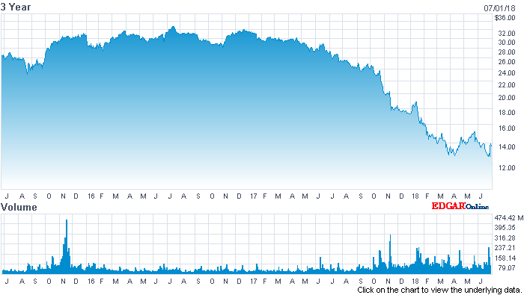

Slide 9

Tesla

Slide 10
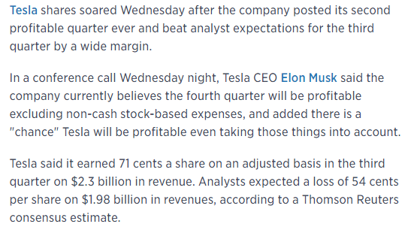
Tesla

Slide 11
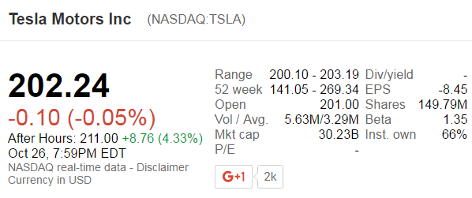
Tesla
Why would companies report earnings after hours when the market is closed?
To allow investors and analysts time to digest the news. Managers will also tend to hide bad news by reporting earnings afterhours, on busy days, on Fridays, and with less advance notice.

Slide 12
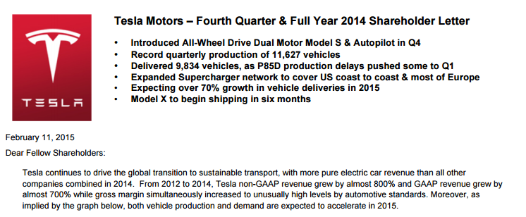
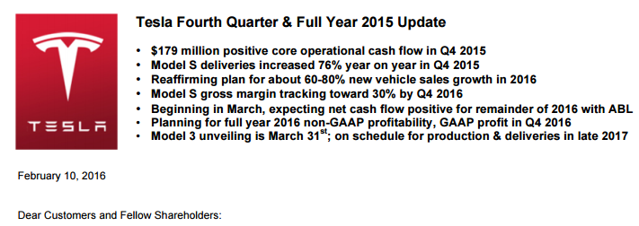

Tesla
Providing both non-GAAP as well as GAAP
Notes:
Accounting is a language, it might be hard at the beginning but by the end of the semester everyone will understand my accent

Slide 13
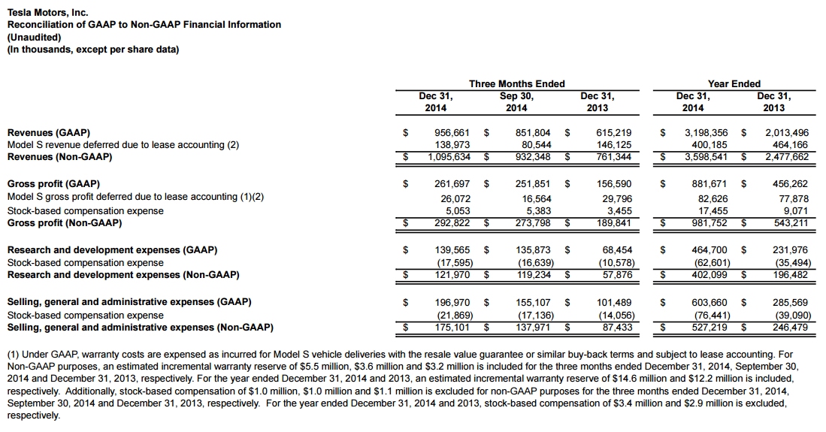
Tesla

Slide 14
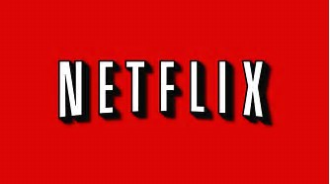
Netflix

Slide 15
Metflix
Netflix surges on strong subscriber growth
Netflix (NFLX) on Monday announced adding more than 5 million subscribers in the June quarter, bringing its total subscriber base to about 104 million.
The strong growth beat Netflix's own estimates and caused the stock to spike 8% in after hours trading.
CNNMoney (New York) July 17, 2017

